Slide 1
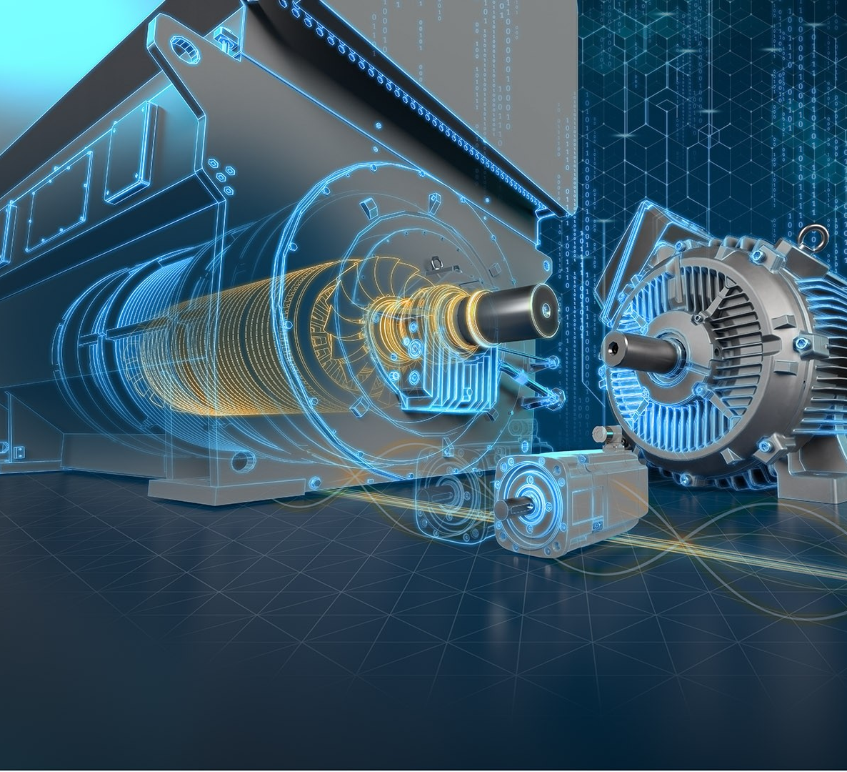
fault detection In a three-phase induction motor
FNU Ujjwal – PF10610
Shikha Patel – JF14891
Sai Saran Akkiraju – DV87374

Slide 2

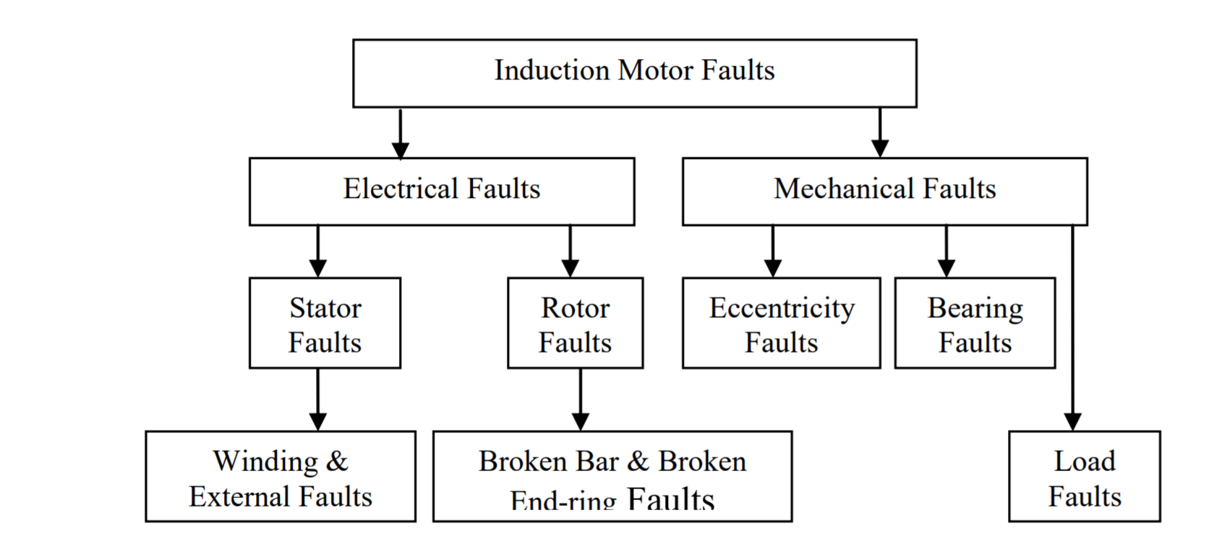




About project
Induction motors are heavily employed in manufacturing industries and are susceptible to different kinds of mechanical failures.
These failures are quite frequent, and they may result in disastrous accidents, such as “economic losses, environmental pollution, and even casualties” (Shao, Sun, Yan, Wang, & Gao, 2017).
“Effective diagnosis of these failures is essential in order to enhance reliability and reduce costs for operation and maintenance of the manufacturing equipment” (Shao, Sun, Yan, Wang, & Gao, 2017).
One of such induction motor failures is a broken rotor bar failure. “A broken rotor bar (BRB) fault causes torque variations and diminishes its amplitude. As a result, mechanical vibrations and increased fluctuation may occur, potentially causing damage to the equipment” (Ramu, Irudayaraj , Subramani, & Subramaniam, 2020).
Figure 1: Types of Induction motor faults
A predictive fault diagnostic system for induction motors employed in a manufacturing industry will be a great asset to avoid above stated problems and keep the plant up and running.

Slide 3
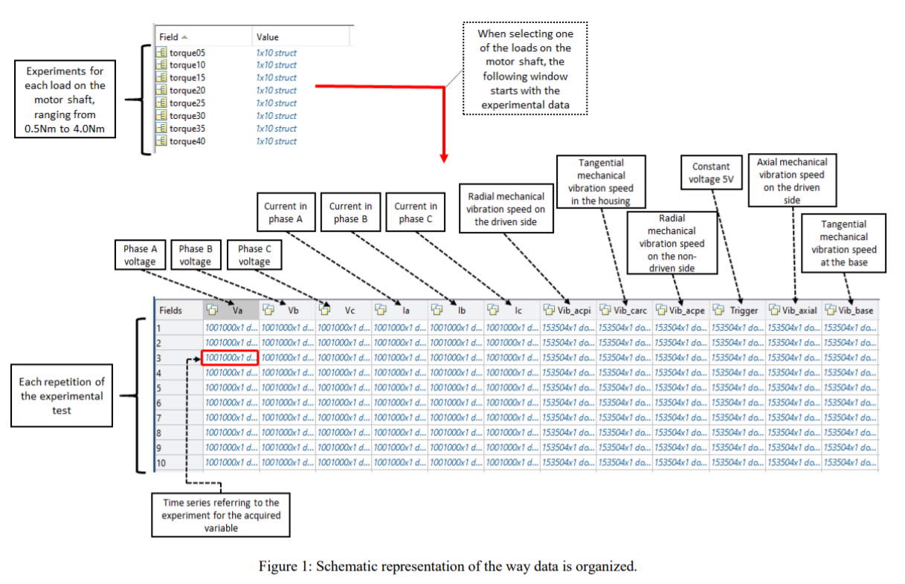
Dataset Description & Origin
Figure 2: Schematic Representation of the dataset organization

Slide 4



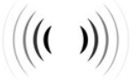
Dataset Description & Origin Cont.
The database is organized as a structure of the MATLAB application.
“struct_healthy” : experimental data referring to the defect less induction motor
“struct_r1b” : rotor with one broken bar
“struct_r2b” : rotor with two broken bars
“struct_r3b” : rotor with three broken bars
“struct_r4b” : rotor with four broken bars.
Dataset Source: IEEE
http://ieee-dataport.org/open-access/experimental-database-detecting-and-diagnosing-rotorbroken-bar-three-phase-induction
Dataset size: 6.7 GB (approx.)
Features of 3phase Induction motor:
Current: 'Ia', 'Ib', 'Ic’
Voltage:’ Va', 'Vb', ‘Vc’
Constant Voltage: 'Trig’
Vibration: 'Vib_acpe', 'Vib_carc', 'Vib_acpi', 'Vib_axial', 'Vib_base'

Slide 5
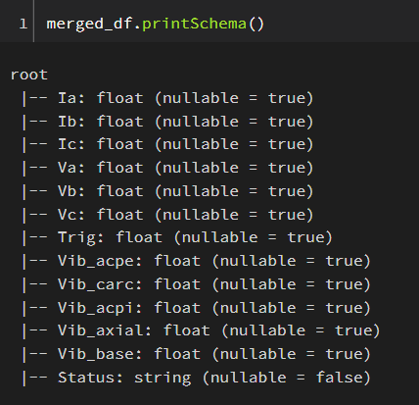
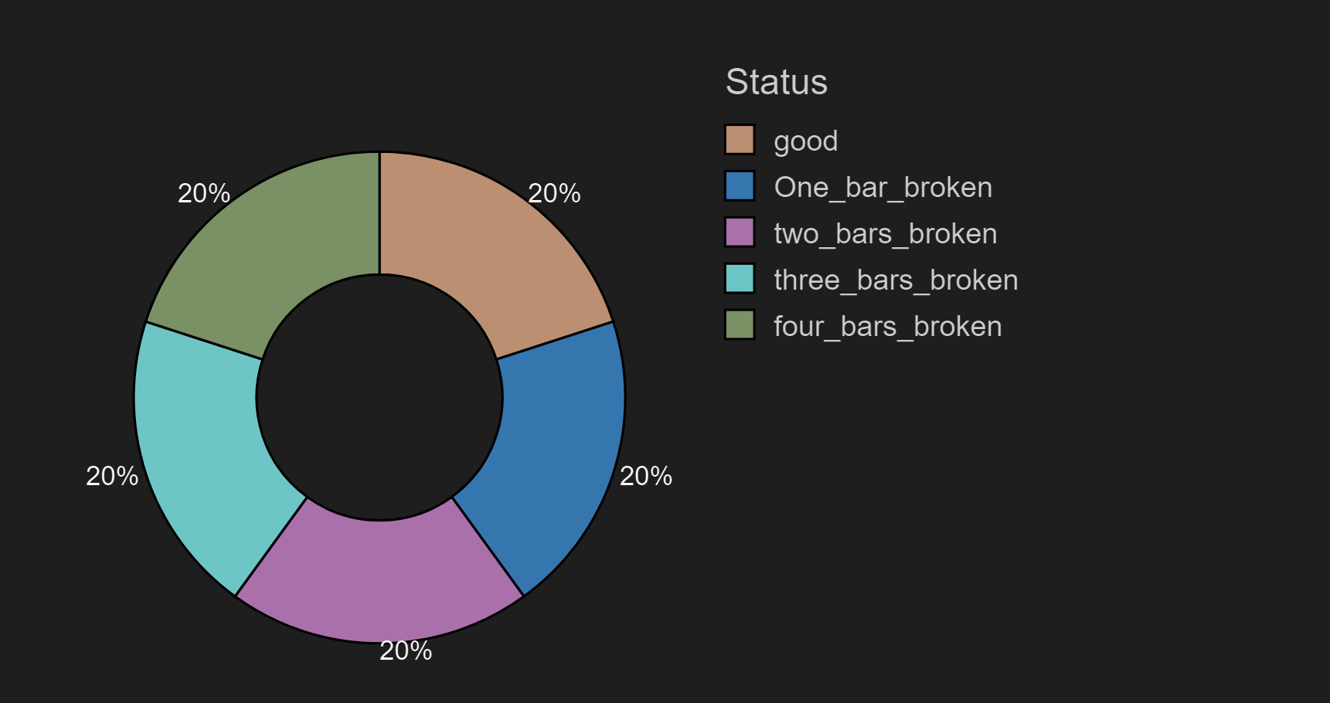
Data Preprocessing
Converted .mat files to .csv
Uploaded the data to Kaggle for future analysis and pulled into Databricks for analysis.
No NAN Values are observed in the datasets.
Status feature is added into each dataset based on the working condition of the motor.
Merged all the five datasets randomly into one for further analysis.
Features are converted from String to Float data type.
20% = 1000000 records
Figure 3: Columns of final dataset prepared for analysis
Figure 4: Distribution of data readings

Slide 6
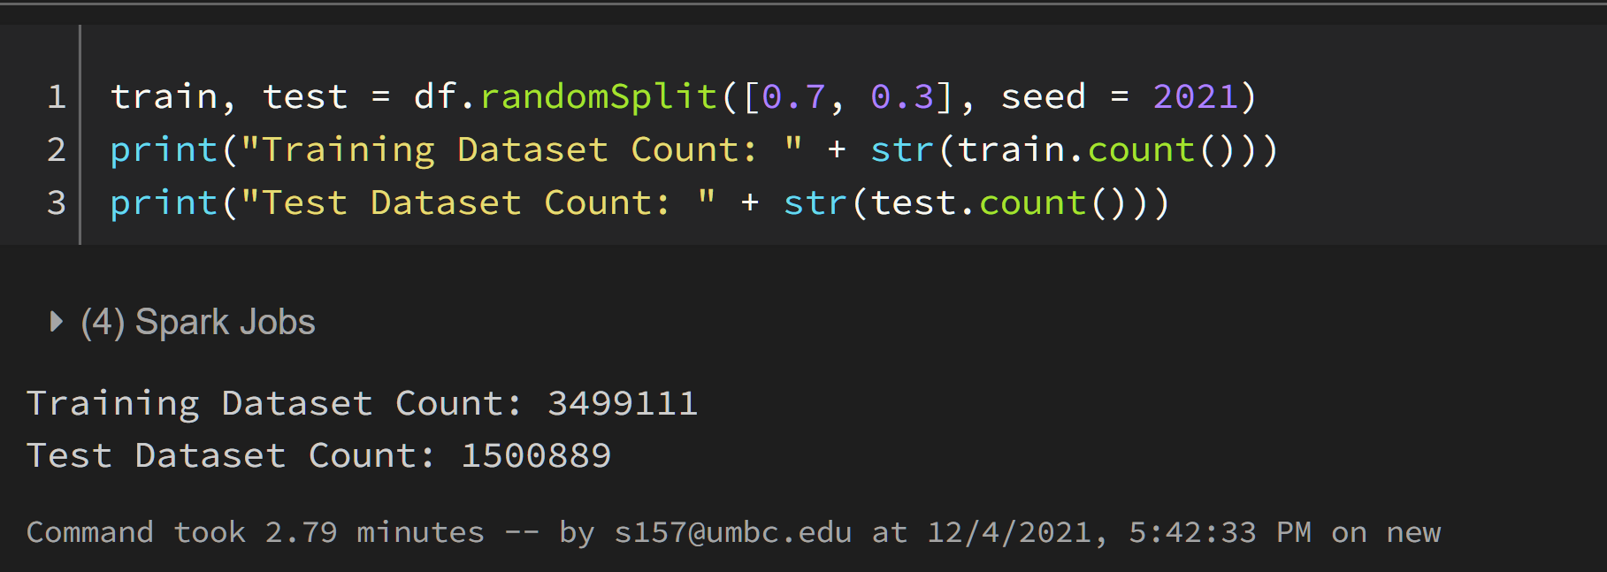
Methodology
Feature Transformation:
PySpark and Spark MLlib along with its features Vector Assembler and String Indexer are selected for feature transformation.
Dataset Split:
Splitting of dataset is done in the ratio of 70% and 30% for training and testing respectively.
Figure 5: Number of readings in Train dataset and Test Dataset

Slide 7
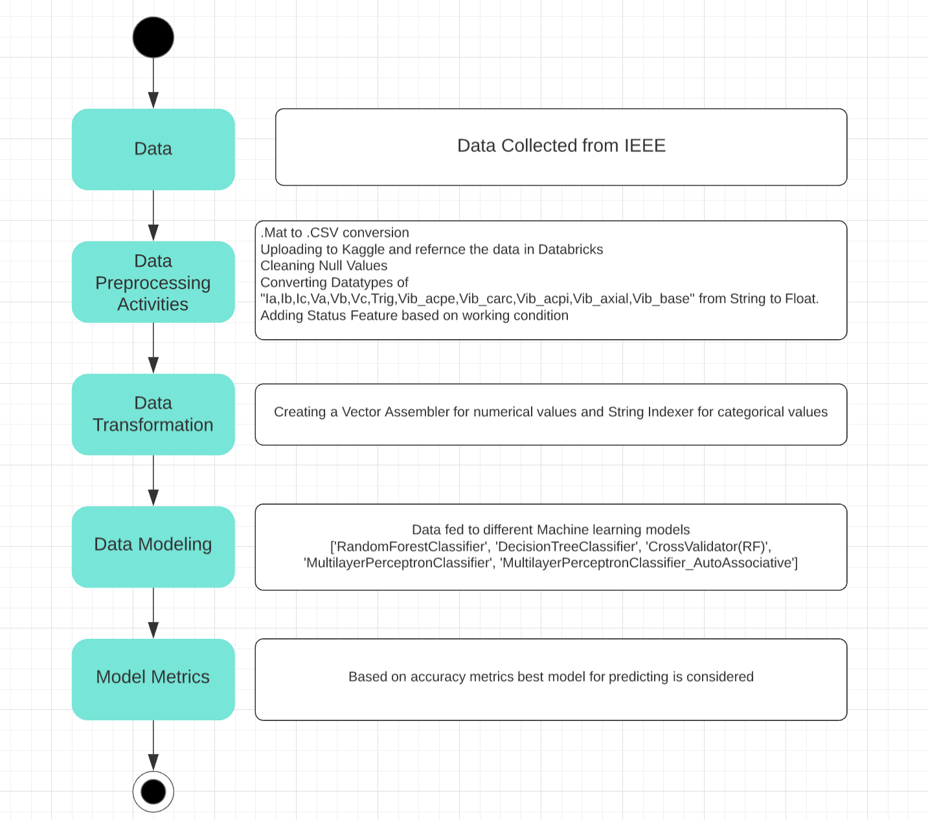
System Activity Flow
Figure 6: Process Flow of Project

Slide 8
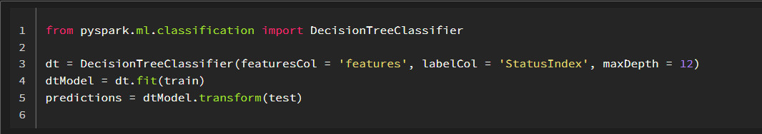
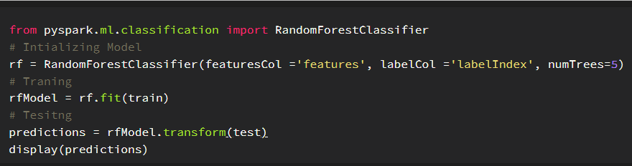
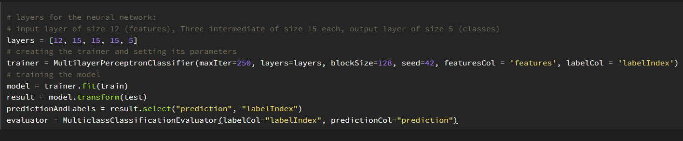
Predictive Modeling
Figure 6: Decision tree model
Decision Tree
Random Forest
Random Forest (Cross validation)
Multilayer Perceptron Classifier
Auto Associative Neural Network
(Multilayer Perceptron Classifier)
Figure 7: Random Forest model
Figure 8: Multi-Layer Perceptron model

Slide 9
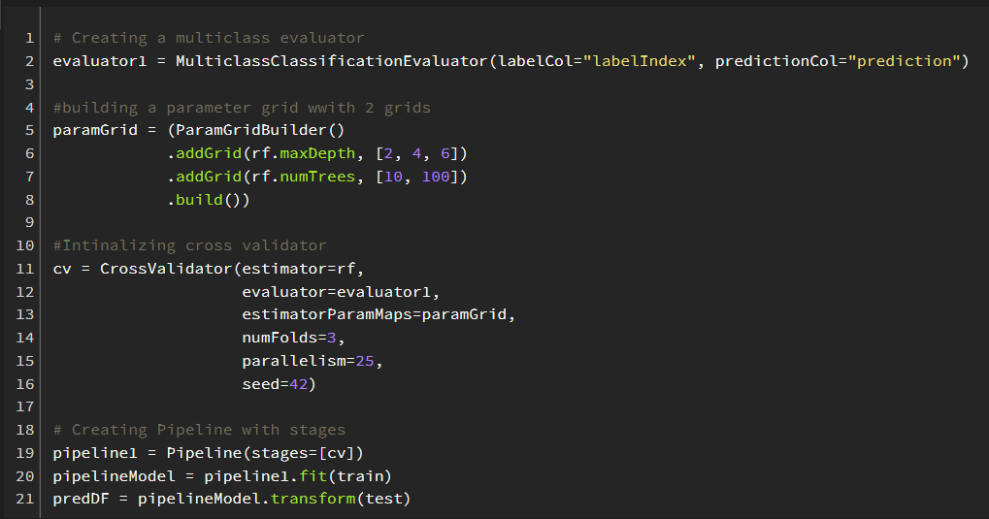
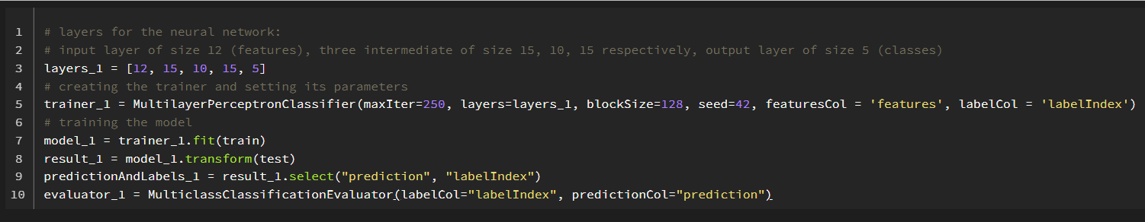
Figure 9: Random Forest model (cross-validation)
Figure 10: Auto-associative neural network model

Slide 10
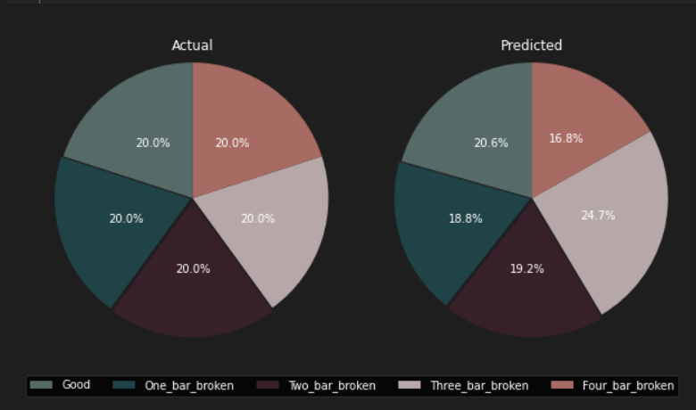
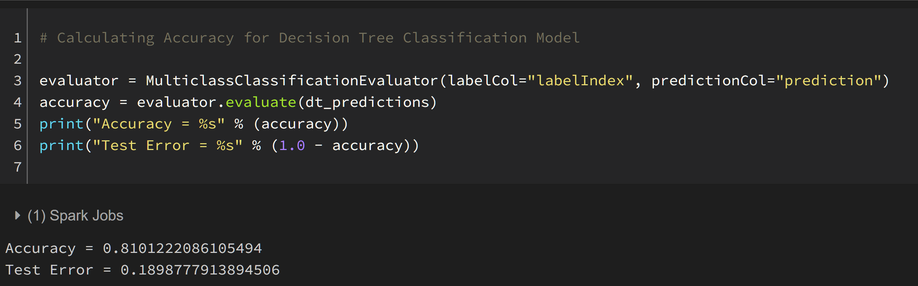
Results
Decision Tree Classifier

Slide 11
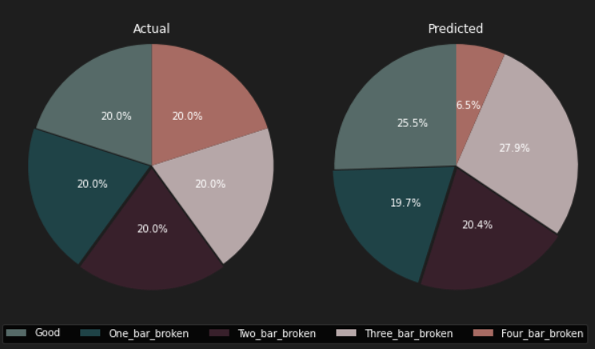
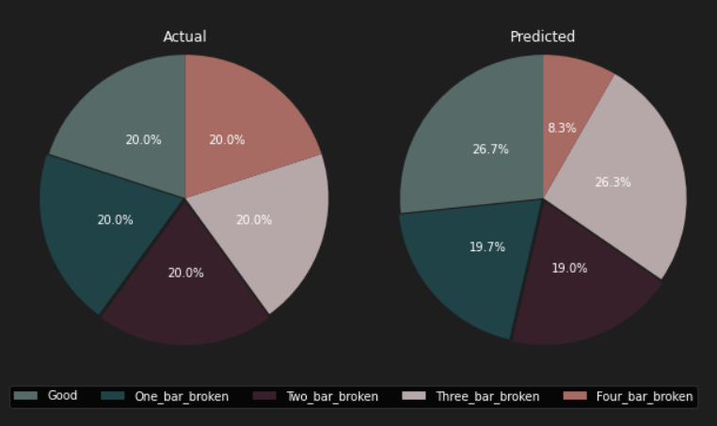
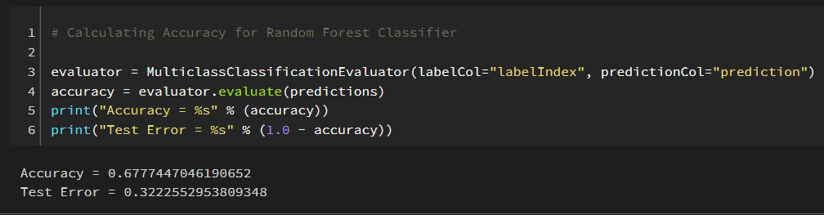
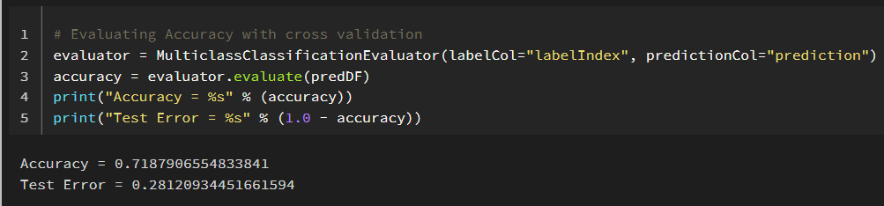
Results Cont.
Random Forest without cross validation
Random Forest with cross validation

Slide 12
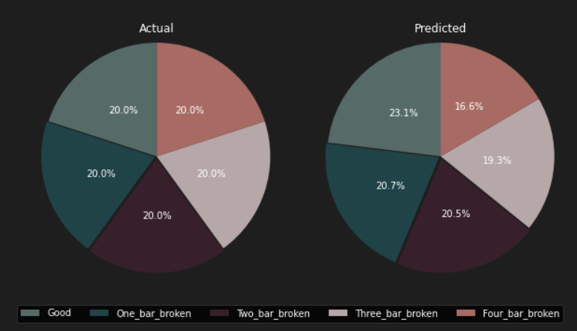
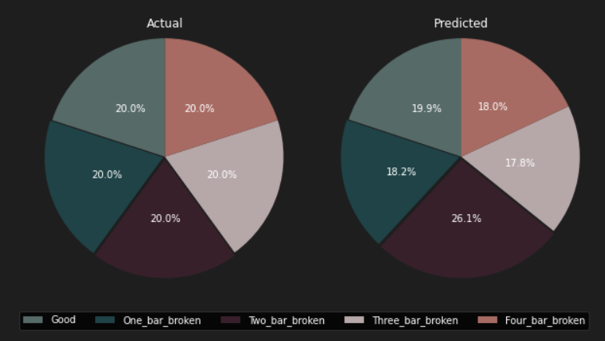
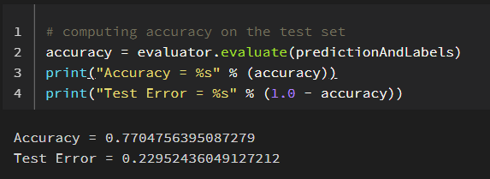
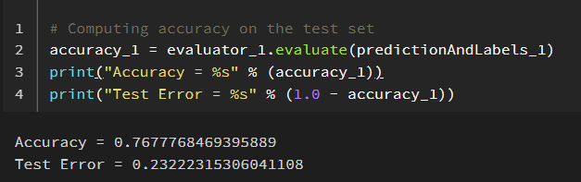
Results Cont.
Perceptron
Autoassociative neural network

Slide 13
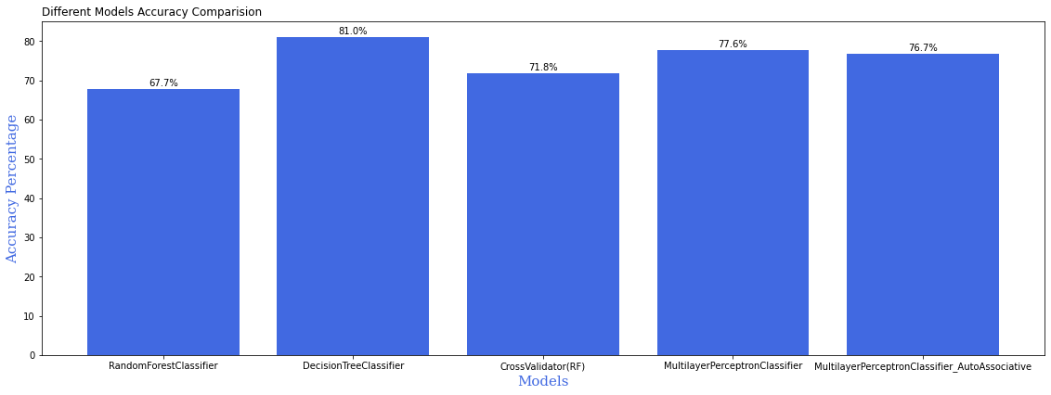
Comparison of Different models
Figure 11: Comparison of model performances
Out of all the models that we implemented we got the best results with Decision tree classifier.

Slide 14



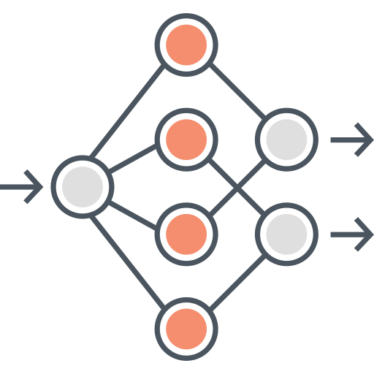
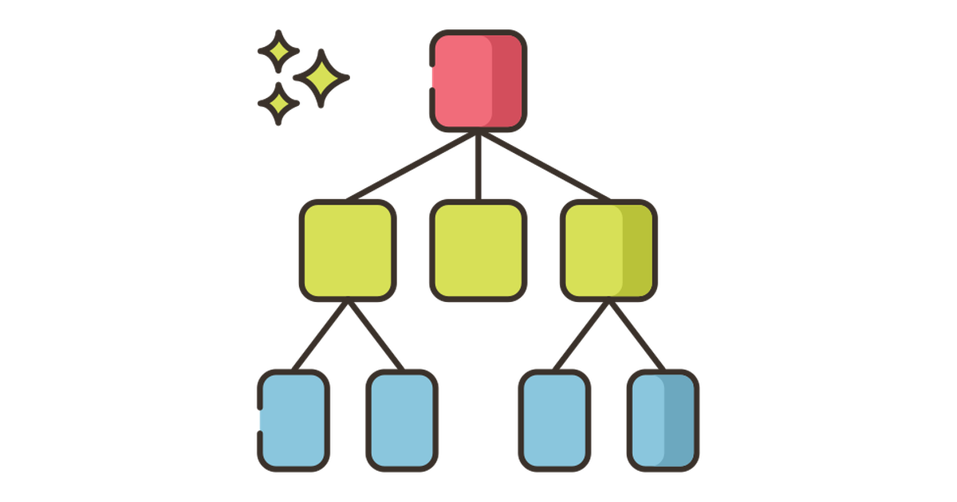
Conclusion
This work depicts the potential of machine learning models in detecting the electrical faults of a three-phase induction motor
The developed models classifies all the test data into their respective classes of broken rotors in an induction motor with accuracy range of 67%-81%.
Out of which the Decision Tree outperformed all the models with the accuracy of 81.5% and Random Forest classifier least performed with an accuracy of 67.7%.
In case of Perceptron neural network and Autoassociative neural network model, the errors in classification can be reduced and the accuracy can be improved by increasing the number of hidden layers and by choosing optimum number of neurons.
The proposed Decision tree model gives accurate results and hence, can be used to prevent event progression during the occurrence of faults and protects the induction motor.

Slide 15







Future scope
The proposed model can serve as an efficient and economical predictive maintenance tool in the future.
Develop ANN based models with hyperparameter tuning: The ANN due to its ability to learn from previous experiences can effectively address catastrophic failures and is perfect to handle non- linearity in data. Hence, with the parameter tuning we can develop an ANN model for better prediction of broken rotor which can be helpful in predictive maintenance in the industry.
To develop a model that can incorporate other features like noise and magnetic flux.
To develop models for different kind of motors like AC motor, DC motor and specialized motors.
To develop models that can effectively distinguish quality of the motors

Slide 16

References
Dineva, A., Mosavi, A., Gyimesi, M., Vajda, I., Nabipour, N., & Rabczuk, T. (2019). Fault Diagnosis of Rotating Electrical Machines Using Multi-Label Classification. Applied Sciences, 23(9).
Ramu, S. K., Irudayaraj , G. C., Subramani, S., & Subramaniam, U. (2020, November). Broken rotor bar fault detection using Hilbert transform and neural networks applied to direct torque control of induction motor drive. IET Power Electronics, 13(15).
Shao, S.-Y., Sun, W.-J., Yan, R.-Q., Wang, P., & Gao, R. X. (2017). A Deep Learning Approach for Fault Diagnosis of Induction Motors in Manufacturing. Chinese Journal of Mechanical Engineering.
Treml, A. E., Flauzino, R. A., Suetake, M., & Maciejewski, N. A. (2020, September). Experimental database for detecting and diagnosing rotor broken bar in a three-phase induction motor. IEEE Dataport. doi:https://dx.doi.org/10.21227/fmnm-bn95

Slide 17
References Cont.
V. Kavana and M. Neethi, "Fault Analysis and Predictive Maintenance of Induction Motor Using Machine Learning," 2018 International Conference on Electrical, Electronics, Communication, Computer, and Optimization Techniques (ICEECCOT), 2018, pp. 963-966, doi: 10.1109/ICEECCOT43722.2018.9001543.
Shahzad, A. (2019, December 11). Meet the Spark MLlib’s Multilayer Perceptron Classifier (MLPC) — Hands-on. Medium. https://medium.com/analytics-vidhya/spark-mllibs-multilayer-perceptron-classifier-mlpc-hands-on-32ac4014eee9
Databricks. Visualizations | Databricks on AWS. https://docs.databricks.com/notebooks/visualizations/index.html
https://spark.apache.org/docs/latest/ml-classification-regression.html

Slide 18

Thank you
FNU Ujjwal – pf10610@umbc.edu | Shikha Patel – jf14891@umbc.edu | Sai Saran Akkiraju – s157@umbc.edu

